Slide 1
AWS CloudFormation
Amar More

Slide 2
What is CloudFormation?
helps you model and set up your AWS resources
you can spend less time managing those resources and more time focusing on your applications that run in AWS
You create a template that describes all the AWS resources that you want and CloudFormation takes care of provisioning and configuring those resources for you
You don't need to individually create and configure AWS resources and figure out what's dependent on what; CloudFormation handles that

Slide 3
Benefits of using CloudFormation
Simplify infrastructure management
Quickly replicate your infrastructure
Easily control and track changes to your infrastructure

Slide 4
Templates in CloudFormation
A CloudFormation template is a JSON or YAML formatted text file
You can save these files with any extension, such as .json, .yaml, .template, or .txt
CloudFormation uses these templates as blueprints for building your AWS resources

Slide 5
Stacks in CloudFormation
When you use CloudFormation, you manage related resources as a single unit called a stack
You create, update, and delete a collection of resources by creating, updating, and deleting stacks
All the resources in a stack are defined by the stack's CloudFormation template

Slide 6
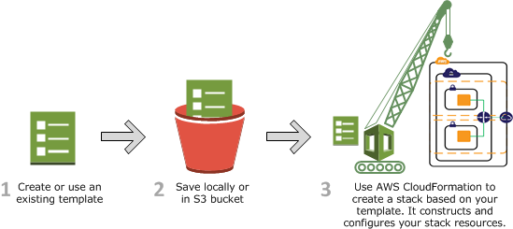
How CloudFormation Works?

Slide 7
Templates in CloudFormation
Components of Template:
Format Version
Description
Metadata
Parameters
Rules
Mappings
Conditions
Transform
Resources
Outputs

Slide 8
Resources in CloudFormation
The required Resources section declares the AWS resources that you want to include in the stack, such as an Amazon EC2 instance or an Amazon S3 bucket
Resources:
Logical ID:
Type: Resource type
Properties:
Set of properties

Slide 9
Resources in CloudFormation
Resources:
MyInstance:
Type: AWS::EC2::Instance
Properties:
AvailabilityZone: ap-south-1a
ImageId: ami-0cca134ec43cf708f
InstanceType: t2.micro

Slide 10
Parameters in CloudFormation
Parameters enable you to input custom values to your template each time you create or update a stack
Defining parameters in a template
Parameters:
InstanceTypeParameter:
Type: String
Default: t2.micro
AllowedValues:
- t2.micro
- m1.small
- m1.large
Description: Enter t2.micro, m1.small, or m1.large. Default is t2.micro.

Slide 11
Parameters in CloudFormation
Referencing the parameters in a template
Ec2Instance:
Type: AWS::EC2::Instance
Properties:
InstanceType:
Ref: InstanceTypeParameter
ImageId: ami-0ff8a91507f77f867

Slide 12
Outputs in CloudFormation
Outputs section declares output values that you can import into other stacks, return in response, or view on the AWS CloudFormation console
Outputs:
Logical ID:
Description: Information about the value
Value: Value to return
Export:
Name: Name of resource to export

Slide 13
Outputs in CloudFormation
Outputs:
InstanceID:
Description: Display Instance ID
Value: !Ref MyInstance
InstancePublicIP:
Description: Display Instance Public IP
Value: !GetAtt MyInstance.PublicIp

Slide 14
Mappings in CloudFormation
Mappings section matches a key to a corresponding set of named values
For example, if you want to set values based on a region, you can create a mapping that uses the region name as a key and contains the values you want to specify for each specific region
You use the Fn::FindInMap intrinsic function to retrieve values in a map

Slide 15
Mappings in CloudFormation
Mappings:
Mapping01:
Key01:
Name: Value01
Key02:
Name: Value02
Key03:
Name: Value03

Slide 16
Mappings in CloudFormation
Mappings:
RegionMap:
us-east-1:
"HVM64": "ami-0ff8a91507f77f867"
us-west-1:
"HVM64": "ami-0bdb828fd58c52235"
eu-west-1:
"HVM64": "ami-047bb4163c506cd98"
ap-southeast-1:
"HVM64": "ami-08569b978cc4dfa10"
ap-northeast-1:
"HVM64": "ami-06cd52961ce9f0d85"

Slide 17
Mappings in CloudFormation
Resources:
myEC2Instance:
Type: "AWS::EC2::Instance"
Properties:
ImageId: !FindInMap [RegionMap, !Ref "AWS::Region", HVM64]
InstanceType: m1.small

Slide 18
Intrinsic Functions in CloudFormation
FindInMap
The intrinsic function Fn::FindInMap returns the value corresponding to keys in a two-level map that's declared in the Mappings section
Mappings:
RegionMap:
us-east-1:
HVM64: "ami-0ff8a91507f77f867"
HVMG2: "ami-0a584ac55a7631c0c"
us-west-1:
HVM64: "ami-0bdb828fd58c52235"
HVMG2: "ami-066ee5fd4a9ef77f1"
eu-west-1:
HVM64: "ami-047bb4163c506cd98"
HVMG2: "ami-31c2f645"

Slide 19
Intrinsic Functions in CloudFormation
FindInMap
Resources:
myEC2Instance:
Type: "AWS::EC2::Instance"
Properties:
ImageId: !FindInMap
- RegionMap
- !Ref 'AWS::Region'
- HVM64
InstanceType: m1.small

Slide 20
Intrinsic Functions in CloudFormation
GetAtt
The Fn::GetAtt intrinsic function returns the value of an attribute from a resource in the template
!GetAtt logicalNameOfResource.attributeName
!GetAtt myInstance.PublicIP

Slide 21
Intrinsic Functions in CloudFormation
GetAZs
The intrinsic function Fn::GetAZs returns an array that lists Availability Zones for a specified region in alphabetical order
Fn::GetAZs: region
Fn::GetAZs: ""
Fn::GetAZs:
Ref: "AWS::Region"
Fn::GetAZs: us-east-1

Slide 22
Intrinsic Functions in CloudFormation
GetAZs:
mySubnet:
Type: "AWS::EC2::Subnet"
Properties:
VpcId:
!Ref VPC
CidrBlock: 10.0.0.0/24
AvailabilityZone:
Fn::Select:
- 0
- Fn::GetAZs: ""

Slide 23
Intrinsic Functions in CloudFormation
Join
The intrinsic function Fn::Join appends a set of values into a single value, separated by the specified delimiter
If a delimiter is the empty string, the set of values are concatenated with no delimiter
!Join [ delimiter, [ comma-delimited list of values ] ]

Slide 24
Intrinsic Functions in CloudFormation
Join
Example
!Join
- ''
- - 'arn:'
- !Ref AWS::Partition
- ':s3:::elasticbeanstalk-*-'
- !Ref AWS::AccountId

Slide 25
Intrinsic Functions in CloudFormation
Length
The intrinsic function Fn::Length returns the number of elements within an array or an intrinsic function that returns an array
Fn::Length : Array
Example
Fn::Length:
!Split ["|", "a|b|c"]

Slide 26
Intrinsic Functions in CloudFormation
Select
The intrinsic function Fn::Select returns a single object from a list of objects by index
!Select [ index, listOfObjects ]
Example
!Select [ "1", [ "apples", "grapes", "oranges", "mangoes" ] ]
AvailabilityZone: !Select
- 0
- Fn::GetAZs: !Ref 'AWS::Region'

Slide 27
Change Sets in CloudFormation
If you need to make changes to the running resources in a stack, you update the stack
Before making changes to your resources, you can generate a change set, which is a summary of your proposed changes
Change sets allow you to see how your changes might impact your running resources, especially for critical resources, before implementing them

Slide 28
Change Sets in CloudFormation
For example, if you change the name of an Amazon RDS database instance, CloudFormation will create a new database and delete the old one
You will lose the data in the old database unless you've already backed it up
If you generate a change set, you will see that your change will cause your database to be replaced, and you will be able to plan accordingly before you update your stack

Slide 29
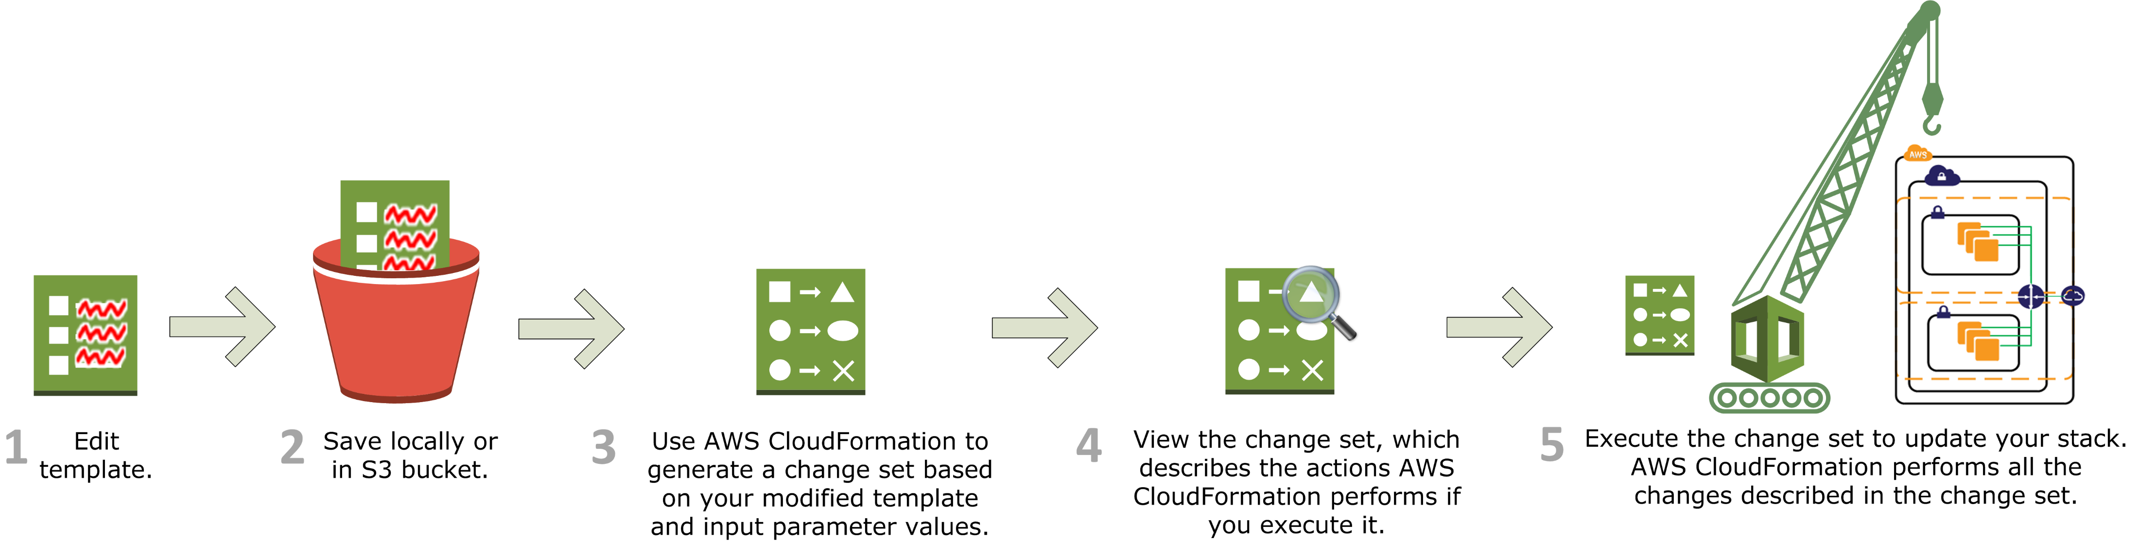
Change Sets in CloudFormation

